Slide 1
Predict Stock Price From LinkedIn Profiles
Yichao Zhang
VS

Slide 2
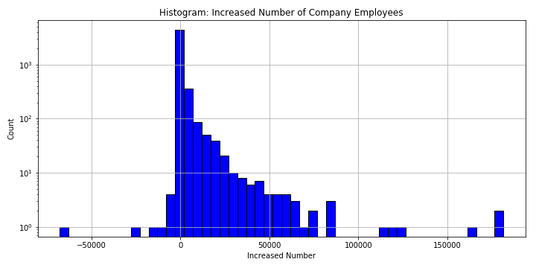
Companies Expansion 2015 - 2018

Slide 3
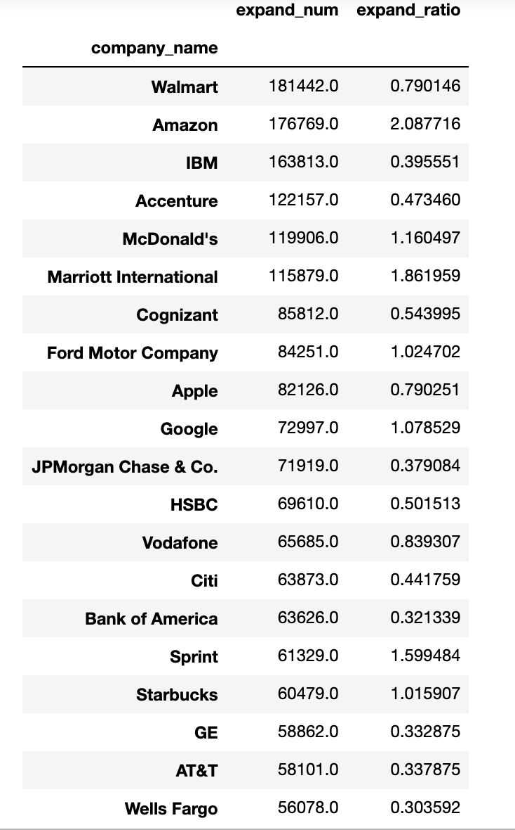
Top 20 Companies

Slide 4
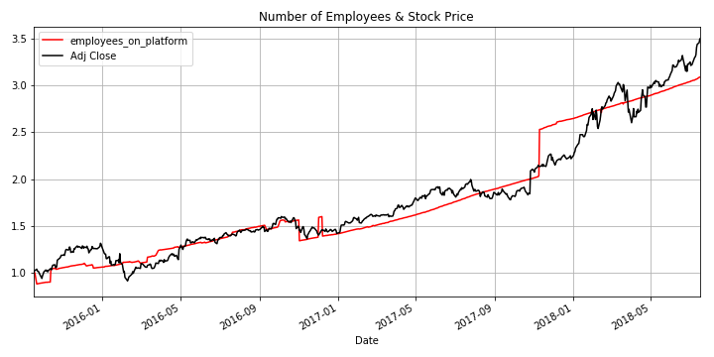
Stock vs Number of Employees: Amazon

Slide 5
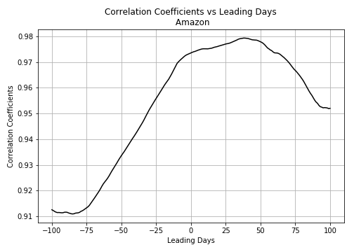
Correlation Coefficients vs Leading Days: Amazon

Slide 6
Leading: Stock Prediction
From LinkedIn Profile
Lagging: Job Seeking
From Stock Price

Slide 7
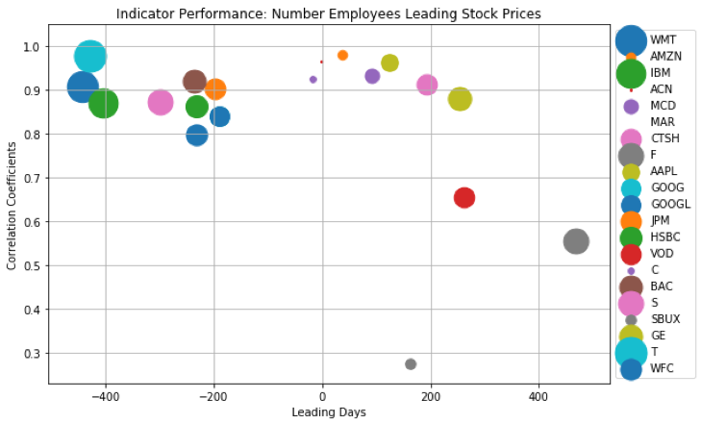
Indicator Performance of Top 20: Number Employees Leading/Lagging Stock Prices

Slide 8
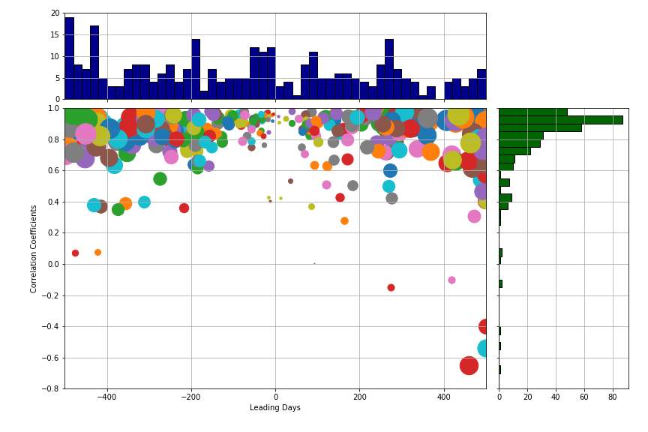
Indicator Performance Search 1900+ companies, whose data cover 2016-2017

Slide 9
Further Steps and Approach:
Split the date range into in sample period ( for training ) and out of sample period ( for testing )
Predictive modeling ( Naive Bayes, Random Forest, LSTM, etc.). Based on the expansion of a company is leading or lagging the stock price, we build 2 different type of models:
Leading model: select companies with high correlation coefficients leading indicators, and build a machine learning model to predict the stock price from the number of employees
Lagging model: select companies with high correlation coefficients lagging indicators, and build a machine learning model to predict the number of employees from the stock price
Explore the followers_count, and add it as an additional indicator into the models
Backtesting in sample and out of sample, fine tune the model
The performance metric:
For regression model (e.g. predict the stock price values), we use Root Mean Square Error (RMSE)
For classification model (e.g. predict of the stock price goes up or down), we use Area Under the Receiver Operating Characteristics (AUROC)

